Slide 1

A Web Framework to Predict Fake News Using ML
Group No: 13
Jaagrut Shah 19204002
Jigar Desai 19204003
Yash Jain 19204013
Guided by:
Prof. Apeksha Mohite
Prof. Geetanjali Kalme
Notes:
1

Slide 2
Contents
Introduction
Objectives
Problem Definition
Technological Stack
Review Suggestions (Given in Last meeting)
Proposed System Architecture/Working
Prototype Design Demonstration
Implementation Status
Status of Paper Draft & Targeted Conference
References
Notes:
2

Slide 3
Introduction
Problem Identified :
The easy access and exponential growth of the information available on social media networks has made it intricate to distinguish between false and true information.
The easy dissemination of information by way of sharing has added to exponential growth of its falsification.
Solution Proposed :
With the help of ML Algorithms, and the data sets we would try to eliminate the fake news which is being spread and trying to alter the emotions of people reading news.
Notes:
3

Slide 4
Objectives
To show the news relevancy and analysis to attain accuracy in anticipating real and dependable news.
To work on this issue, a layered model is proposed, which fine-tunes the informational insight received from the data at each phase before attempting a prediction.
To use a variety of Machine Learning approaches, achieve demonstrable success in the prediction of fake news and posts.
To eliminate the propagation of false information on social media that may mislead users.
To be able to give more and more accurate news on the screen.
Notes:
4

Slide 5
Technology Stack
Software Requirements:
Python libraries
Front-end: Html5, Css3+ Bootstrap, JavaScript
Framework: Flask
Database: PostgreSQL, Monitor using PG Admin
Machine-Learning Classification models
OS Requirements: Windows XP or above
JavaScript supported browsers
Hardware Requirements:
Minimum 2GB Ram
Pentium / Intel i3 Processors or above
Notes:
5

Slide 6
Review Suggestions
Our product received positive feedback, although there were a few additions that are noted below:
1. Including Sentiment Analysis in our project
2. Adding a feedback mechanism for our website’s visitors
We intend to utilize natural language processing for sentiment analysis, and for the feedback system, we would record user information in a database together with the votes he offered to be fake or true. (This will be combined with machine prediction and sentiments with the news as well.)

Slide 7
Proposed System Architecture

Slide 8
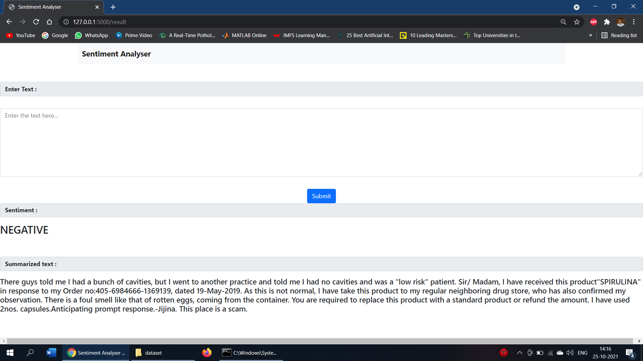
Prototype Design Demonstration

Slide 9
Implementation Status
Obtaining dataset from Kaggle and completing text pre-processing. (objective 1)
Applying Classification Models to the data set and creating flask app to take manual input and output prediction. (objective 2)
Creating flask app for summarization and sentiment analysis to take manual input and output prediction. (objective 3)
Merging objective 2 and 3 form one flask app. (objective 4)

Slide 10
Status of Paper Draft & Targeted Conference
Paper completed and sent to guide.
Ready need to be approved by guide.
Not submitted in conference.
Conference Targeted: 2nd International Conference on Advanced computing Technologies in Engineering
Deadline: April 27, 2022

Slide 11
References
]Shu, K., Sliva, A., Wang, S., Tang, J., & Liu, H. (2017). “Fake news detection on social media: A data mining perspective”. ACM SIGKDD Explorations Newsletter, 19(1), 22-36.
Thota, Aswini; Tilak, Priyanka; Ahluwalia, Simrat; and Lohia, Nibrat (2018) "Fake News Detection: A Deep Learning Approach," SMU Data Science Review: Vol. 1: No. 3, Article 10.
Reis, J. C., Correia, A., Murai, F., Veloso, A., Benevenuto, F., & Cambria, E. (2019). “Supervised Learning for Fake News Detection”. IEEE Intelligent Systems, 34(2), 76-81.
Atik Mahabub, “A robust technique of fake news detection using Ensemble Voting Classifier and comparison with other classifiers”, Springer nature 2019.

Slide 12
Thank You...!!
Notes:
12

